Slide 1
Daily Weather Data Analysis
Students :
mohmmad Shabaro
Odai aldabbas

Slide 2
Data Loading and Cleaning
Input
df = pd.read_csv("weatherHistory.csv")
df['Formatted Date'] = pd.to_datetime(df['Formatted Date'], utc=True)
df.set_index('Formatted Date', inplace=True)
df.index = pd.to_datetime(df.index)
df.dropna(inplace=True)

Slide 3
Basic Statistics
Input
print("Temperature (C):")
print("Mean:", df['Temperature (C)'].mean())
print("Median:", df['Temperature (C)'].median())
print("Max:", df['Temperature (C)'].max())
print("Min:", df['Temperature (C)'].min())
print("\nHumidity:")
print("Mean:", df['Humidity'].mean())
print("Median:", df['Humidity'].median())
print("Max:", df['Humidity'].max())
print("Min:", df['Humidity'].min())

Slide 4
Basic Statistics
print("\nWind Speed (km/h):")
print("Mean:", df['Wind Speed (km/h)'].mean())
print("Median:", df['Wind Speed (km/h)'].median())
print("Max:", df['Wind Speed (km/h)'].max())
print("Min:", df['Wind Speed (km/h)'].min())
print("\nWeather condition counts:")
print(df['Precip Type'].value_counts())
if 'Summary' in df.columns:
summary_lower = df['Summary'].str.lower()
sunny_days = summary_lower.str.contains("sun|clear").sum()
cloudy_days = summary_lower.str.contains("cloud").sum()
print("\nSunny days (from Summary):", sunny_days)
print("Cloudy days (from Summary):", cloudy_days)
else:
print("\nColumn 'Summary' not found, skipping sunny/cloudy counts.")

Slide 5
Basic Statistics
Output
Temperature (C):
Mean: 11.940975696760804
Median: 12.033333333333331
Max: 39.90555555555555
Min: -21.822222222222223
Humidity:
Mean: 0.7348409356237491
Median: 0.78
Max: 1.0
Min: 0.0

Slide 6
Basic Statistics
Wind Speed (km/h):
Mean: 10.804935617495
Median: 9.9337
Max: 63.8526
Min: 0.0
Weather condition counts:
Precip Type
rain 85224
snow 10712
Name: count, dtype: int64
Sunny days (from Summary): 10763
Cloudy days (from Summary): 60711

Slide 7
Univariate Analysis
Input
plt.hist(df['Temperature (C)'], bins=30, color='skyblue')
plt.title('Temperature Distribution')
plt.xlabel('Temperature (C)')
plt.ylabel('Frequency')
plt.show()
df['Precip Type'].value_counts().plot(kind='bar', title='Weather Conditions')
plt.xlabel('Condition')
plt.ylabel('Count')
plt.show()

Slide 8
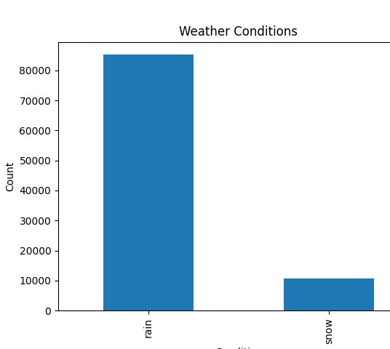
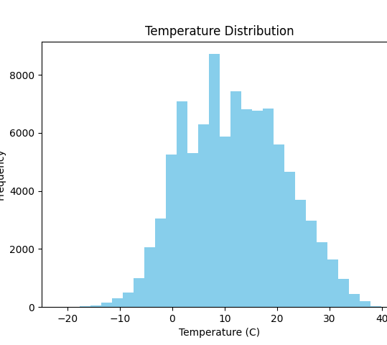
Univariate Analysis
Output

Slide 9
Time Series Trends
Input
monthly_avg_temp = df['Temperature (C)'].resample('ME').mean()
monthly_avg_temp.plot(title='Monthly Average Temperature')
plt.ylabel('Temperature (C)')
plt.show()
monthly_avg_humidity = df['Humidity'].resample('ME').mean()
monthly_avg_humidity.plot(title='Monthly Average Humidity', color='green')
plt.ylabel('Humidity')
plt.show()
monthly_rainy_days = df[df['Precip Type'] == 'rain']['Precip Type'].resample('ME').count()
monthly_rainy_days.plot(title='Monthly Count of Rainy Days', color='blue')
plt.ylabel('Number of Rainy Days')
plt.show()

Slide 10
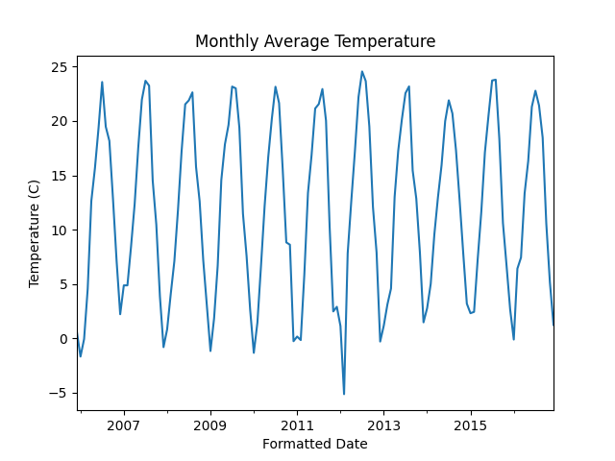
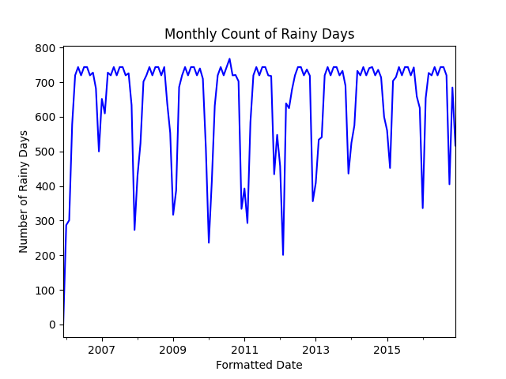
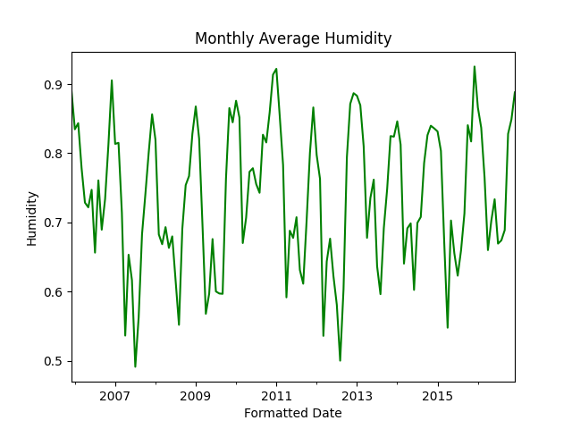
Time Series Trends
Output

Slide 11
Bivariate Analysis
Input
plt.scatter(df['Temperature (C)'], df['Humidity'], alpha=0.5)
plt.title('Temperature vs Humidity')
plt.xlabel('Temperature (C)')
plt.ylabel('Humidity')
plt.show()
corr = df.corr(numeric_only=True)
fig, ax = plt.subplots(figsize=(8, 6))
cax = ax.matshow(corr, cmap='coolwarm')
plt.xticks(range(len(corr.columns)), corr.columns, rotation=90)
plt.yticks(range(len(corr.columns)), corr.columns)
fig.colorbar(cax)

Slide 12
Bivariate Analysis
plt.title('Correlation Matrix Heatmap')
plt.show()
df.boxplot(column='Temperature (C)', by='Precip Type')
plt.title('Temperature by Weather Type')
plt.suptitle('')
plt.xlabel('Weather Type')
plt.ylabel('Temperature (C)')
plt.show()

Slide 13
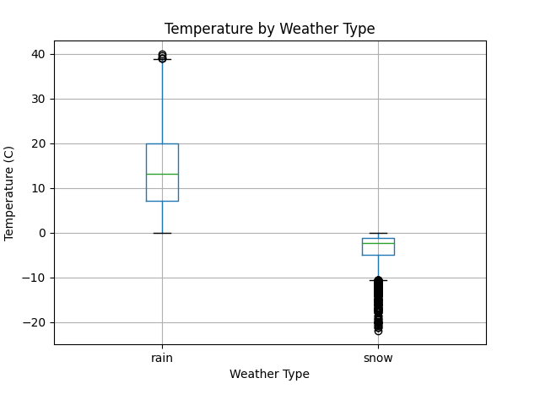
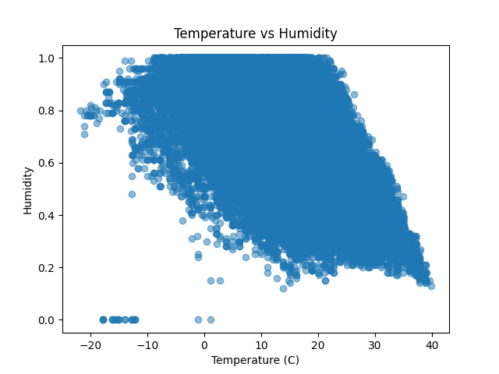
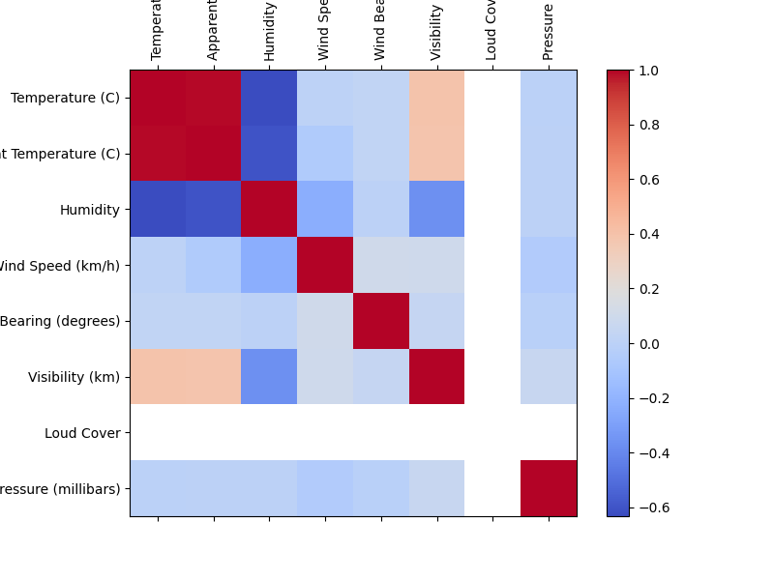
Bivariate Analysis
Output

Slide 14
Key Questions to Explore
Input
coldest = df['Temperature (C)'].idxmin()
hottest = df['Temperature (C)'].idxmax()
print("\nColdest Day:", coldest)
print("Hottest Day:", hottest)
rainy = df[df['Precip Type'] == 'rain']
non_rainy = df[df['Precip Type'] != 'rain']
print("\nAverage Temperature on Rainy Days:", rainy['Temperature (C)'].mean())
print("Average Temperature on Non-Rainy Days:", non_rainy['Temperature (C)'].mean())
print("\nAverage Wind Speed by Weather Type:")
print(df.groupby('Precip Type')['Wind Speed (km/h)'].mean())

Slide 15
Key Questions to Explore
Output
Coldest Day: 2012-02-10 06:00:00+00:00
Hottest Day: 2007-07-22 13:00:00+00:00
Average Temperature on Rainy Days: 13.85298931182661
Average Temperature on Non-Rainy Days: -3.2708846776201144
Average Wind Speed by Weather Type:
Precip Type
rain 10.971219
snow 9.481998
Name: Wind Speed (km/h), dtype: float64

Slide 16
Visualization & Reporting
Visualization
Visualizations included above (Histogram, Line Plot, Scatter Plot, Box Plot, Heatmap, Bar Chart).
Reporting
The reporting file has been attached with the project on GitHub link.

